Slide 1
Individual homework
Vescan Antonia

Slide 2
Problem statement
Exercise 7.8
Simplify the following Boolean functions of 4 variables given by their values 1, using Quine’s method.
f8(1,1,1,1) = f8(1,1,1,0) = f8(1,1,0,0) = f8(1,0,0,0) = f8(0,0,0,0) = f8(0,0,1,0) = f8(1,0,1,1) = f8(0,0,1,1) = 1

Slide 3
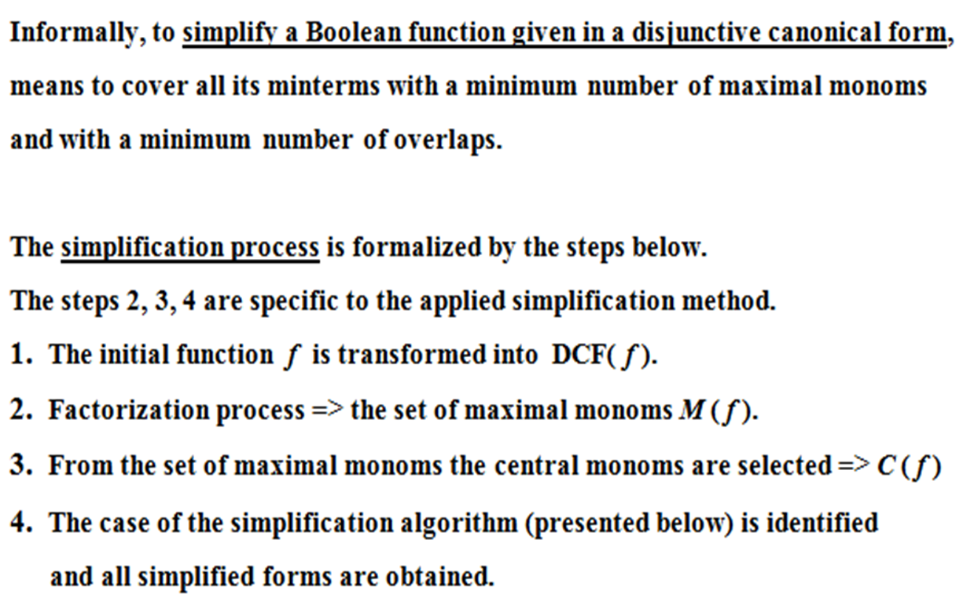
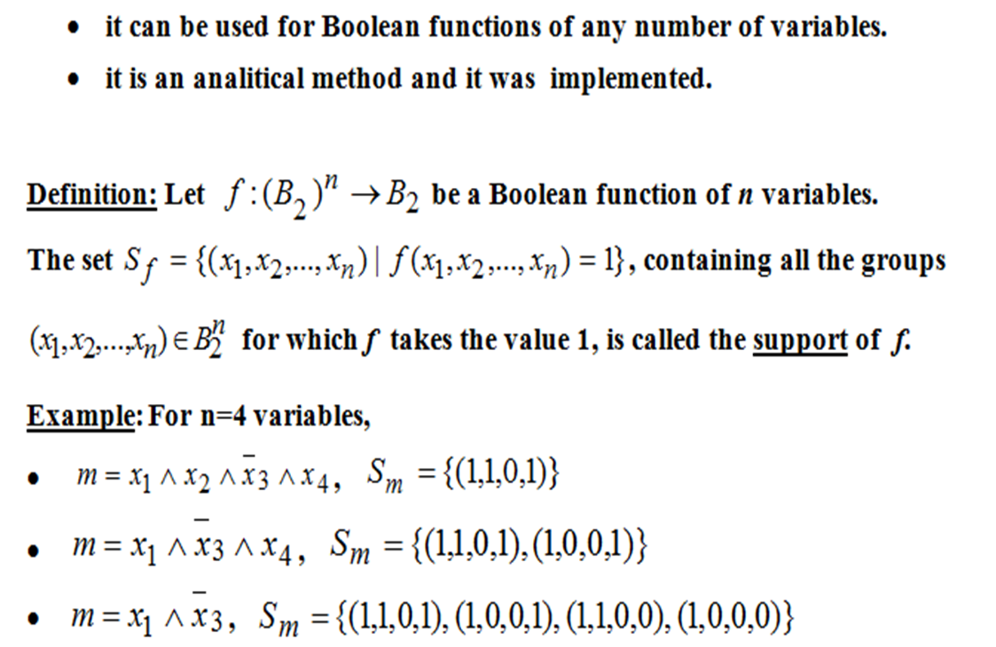
Theoretical Results
Quine’s method:

Slide 4
X₁ | X₂ | X₃ | X₄ | f(X₁,X₂,X₃,X₄)
0 | 0 | 0 | 0 | 1
0 | 0 | 1 | 0 | 1
0 | 0 | 1 | 1 | 1
1 | 0 | 0 | 0 | 1
1 | 0 | 1 | 1 | 1
1 | 1 | 0 | 0 | 1
1 | 1 | 1 | 0 | 1
1 | 1 | 1 | 1 | 1
_ _ _ _ _ _ _ _ _ _ _ _ _ _ _ _
f(X₁,X₂,X₃,X₄) = X₁X₂X₃X₄ V X₁X₂X₃X₄ V X₁X₂X₃X₄ V X₁X₂X₃X₄ V X₁X₂X₃X₄ V X₁X₂X₃X₄ V X₁X₂X₃X₄ V X₁X₂X₃X₄
The ascending order, with respect to the number of “1” values in each group:
Sf = {(0,0,0,0), (1,0,0,0), (0,0,1,0),(1,1,0,0), (0,0,1,1), (1,1,1,0), (1,0,1,1), (1,1,1,1)}

Slide 5
Group: | X₁ | X₂ | X₃ | X₄
I | 0 | 0 | 0 | 0 | m0
II | 1 | 0 | 0 | 0 | m8
 | 0 | 0 | 1 | 0 | m2
III | 1 | 1 | 0 | 0 | m12
 | 0 | 0 | 1 | 1 | m3
IV | 1 | 1 | 1 | 0 | m14
 | 1 | 0 | 1 | 1 | m11
V | 1 | 1 | 1 | 1 | m15
VI=I+II | - | 0 | 0 | 0 | _ _ _ m₀Vm₈ = X₂X₃X₄ = max₁
 | 0 | 0 | - | 0 | _ _ _ m₀Vm₂ = X₁X₂X₄ = max₂
VII=II+III | 1 | - | 0 | 0 | _ _ m₈Vm₁₂ = X₁X₃X₄ = max₃
 | 0 | 0 | 1 | - | _ _ m₂Vm₃ = X₁X₂X₃ = max₄
VIII=III+IV | 1 | 1 | - | 0 | _ m₁₂Vm₁₄ = X₁X₂X₄ = max₅
 | - | 0 | 1 | 1 | _ m₃Vm₁₁ = X₂X₃X₄ = max₆
IX=IV+V | 1 | 1 | 1 | - | m₁₄Vm₁₅ = X₁X₂X₃ = max₇
 | 1 | - | 1 | 1 | m₁₁Vm₁₅ = X₁X₃X₄ = max₈

Slide 6
 | max1 | max2 | max3 | max4 | max5 | max6 | max7 | max8
m0 | * | *
m8 | * |  | *
m2 |  | * |  | *
m12 |  |  | * |  | *
M3 |  |  |  | * |  | *
M14 |  |  |  |  | * |  | *
m11 |  |  |  |  |  | * |  | *
m15 |  |  |  |  |  |  | * | *
There is no (*) which is unique on a certain row, all the minterms are covered by two maximal monoms. C(f8) = Ø. Two simplified forms are: _ _ _ _ _
f1(x1,x2,x3,x4) = max1 V max4 V max5 V max8 =x2x3x4 V x1x2x3 V x1x2x4 V x1x3x4 _ _ _ _ _
f2(x1,x2,x3,x4) = max2 V max3 V max6 V max7 = x1x2x4 V x1x3x4 V x2x3x4 V x1x2x3

